Slide 1
Hello, boys and girls!
My name’s
Rimma Mustafaevna

Slide 2
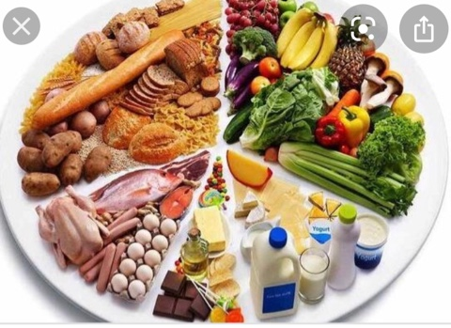

Slide 3
The topic of our lesson is “My Favourite Food”

Slide 4
[i:] bean, tea, meat, cheese [ɑ:] jar, carton, glass [ɒ] olive oil, bottle, coffee [ʤ] jam, juice, vegetable [ʃ] fish, dish, sugar

Slide 5
Traditional English Breakfast

Slide 6
Countable nouns
Uncountable nouns
one lime –
two limes
one melon –
three melons
one orange –
four oranges
one apple – five apples
cheese
milk
porridge
meat
olive oil
bread

Slide 7
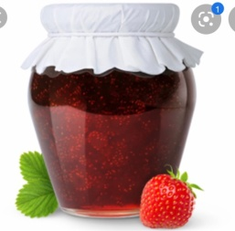
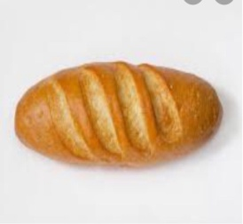
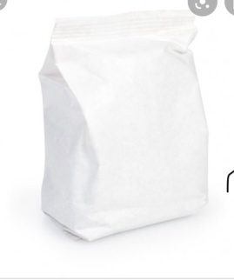
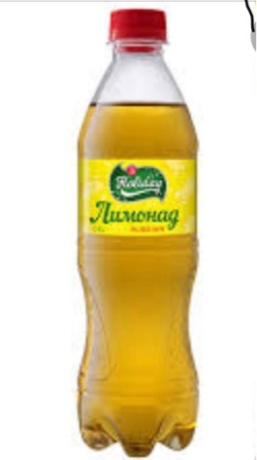
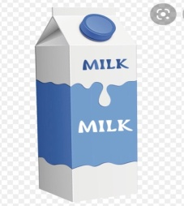
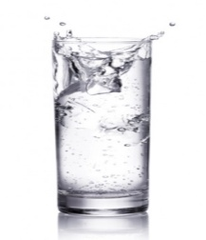
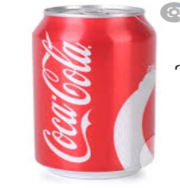
a jar of jam
a loaf of bread
a packet of flour
a bottle of lemonade
a carton of milk
a glass of water
a can of cola

Slide 8
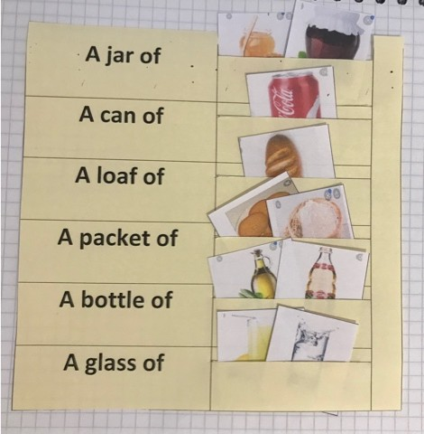

Slide 9
М
Н
О
Г
О
(+) a lot of (count./uncount.nouns)
(-/?) many
(count.nouns)
(-/?) much
(uncount.nouns)

Slide 10
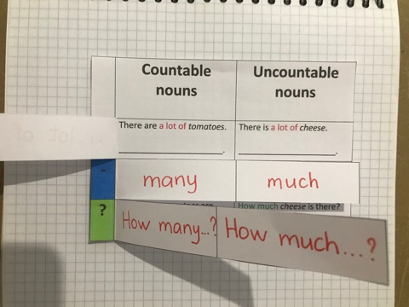
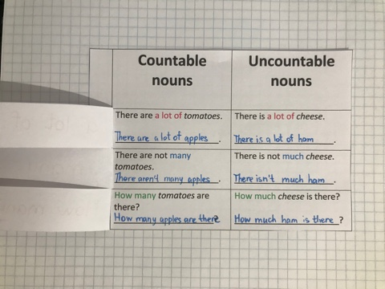

Slide 11
-How many bottles of milk are there? -There are 3 bottles of milk on the table.

Slide 12
Correct the mistakes
There is many cheese in the fridge.
Are there a lot of limes on the plate?
There aren’t much strawberries in the basket.
How many honey is there?

Slide 13
There is a bottle of bread.
There is a can of jam.
There are two plates of cola.
There are five jars of milk.

Slide 15
Now I know…
Now I can…

