Slide 1
Hello, boys and girls!
My name’s
Rimma Mustafaevna

Slide 2
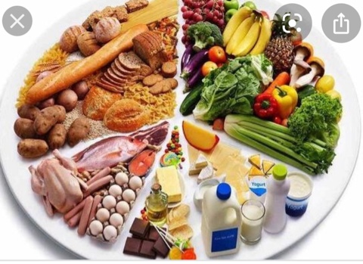

Slide 3
The Topic of Our Lesson is “FOOD”

Slide 4
By the end of the lesson you can:
use countable and uncountable nouns;
use “would like” in your everyday speech

Slide 5
By the end of the lesson you can:
use countable and uncountable nouns;
use “would like” in your everyday speech

Slide 6
[i:] pea, meat, tea
[ʃ] fish, dish, sugar
[tʃ] chicken, cheese, peach
[ʤ] jam, sandwich, vegetable

Slide 7
Countable nouns
a/an
Uncountable nouns
some
a carrot
a lemon
an orange
an apple
some cheese
some milk
some porridge
some meat

Slide 8
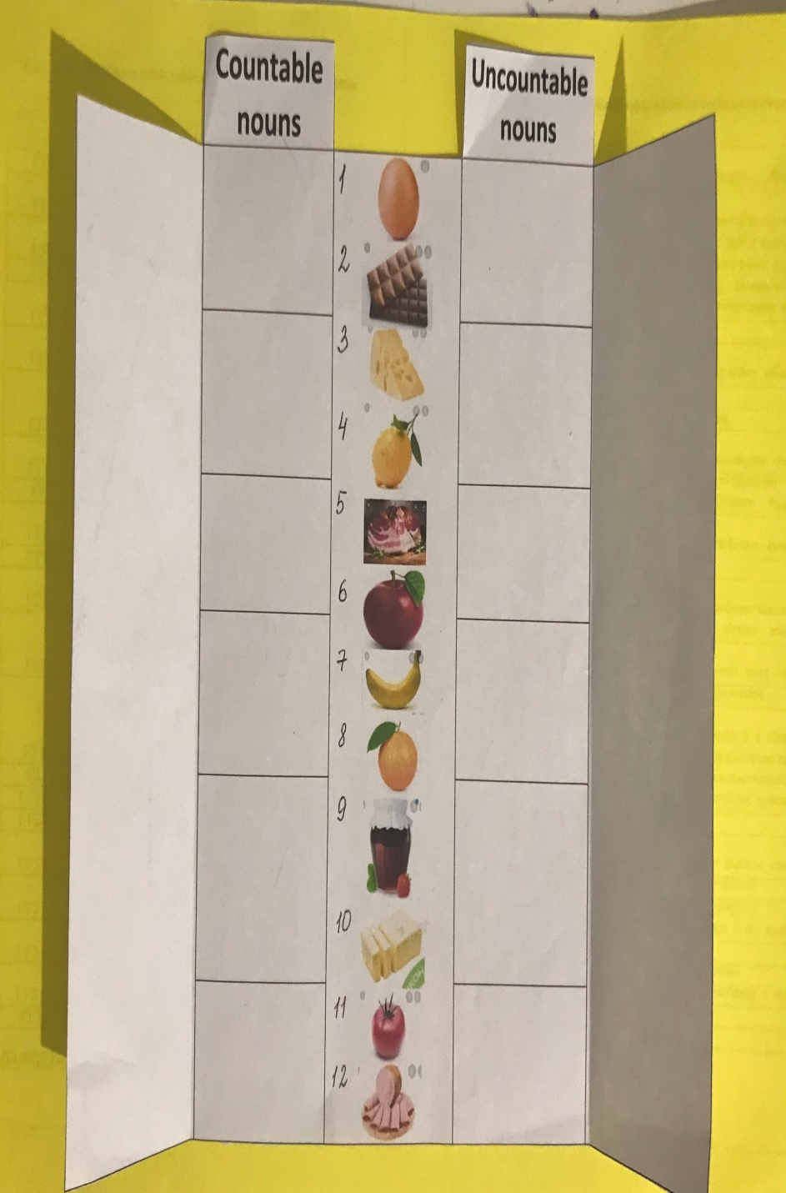
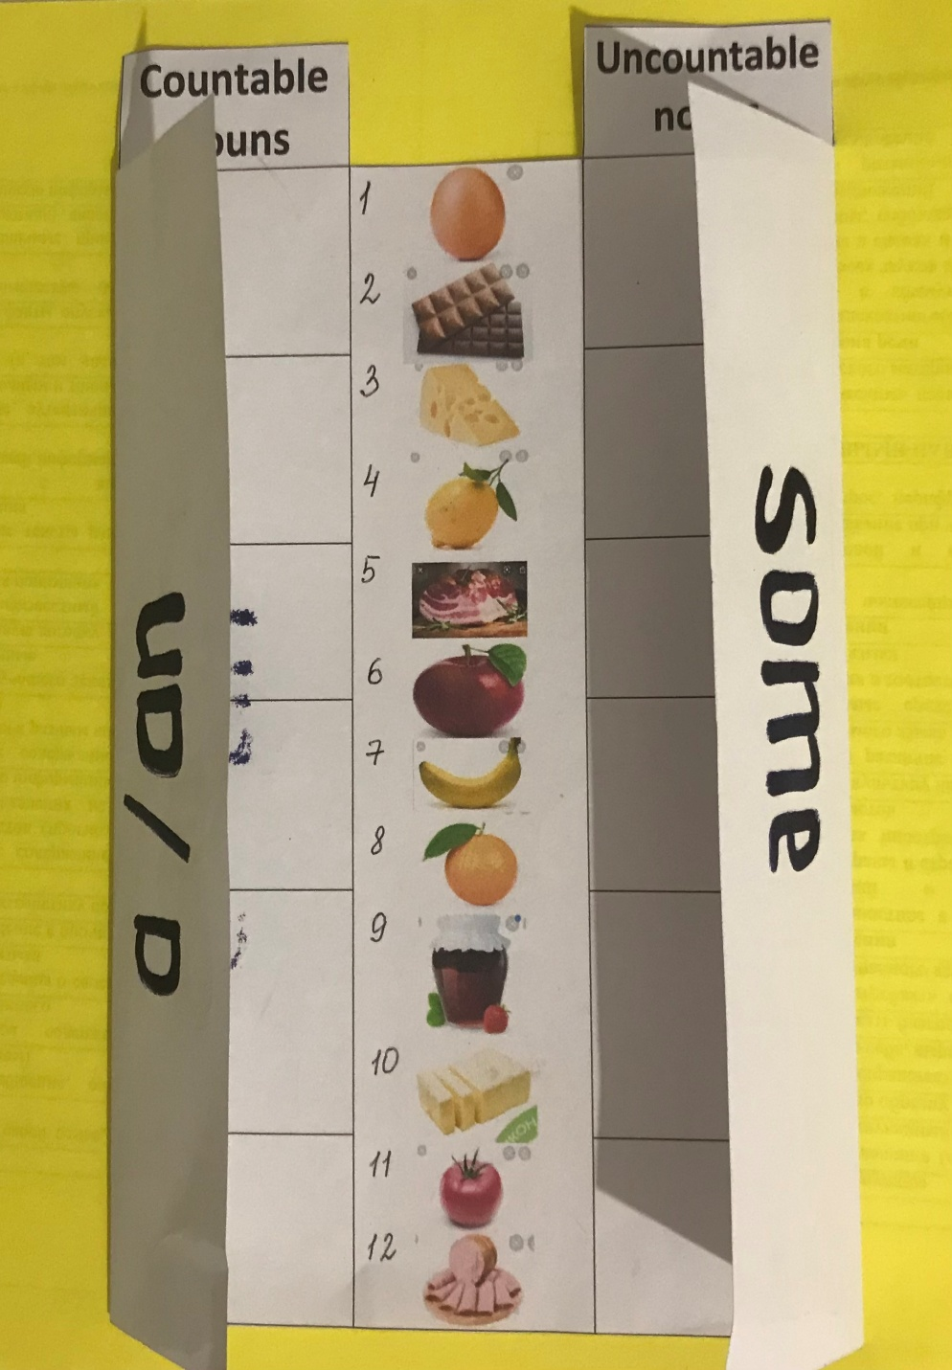

Slide 9
Do you like bananas?
(Ты любишь…?)
- Yes, I do.
- No, I don’t.
Would you like
a cup of tea?
(Ты бы хотел…?)
- Yes, please.
- No, thanks.

Slide 10
1. What would you like for lunch today, Sam? What about some fish and potatoes? - No, thanks. Can I have chicken and rice? I like chicken and rice a lot more. | 2. What would you like for breakfast, Fred? What about porridge? I would like bacon and eggs, please. I don’t like porridge. Kate, what about cornflakes with milk? Yes, please. I like cornflakes.

Slide 11
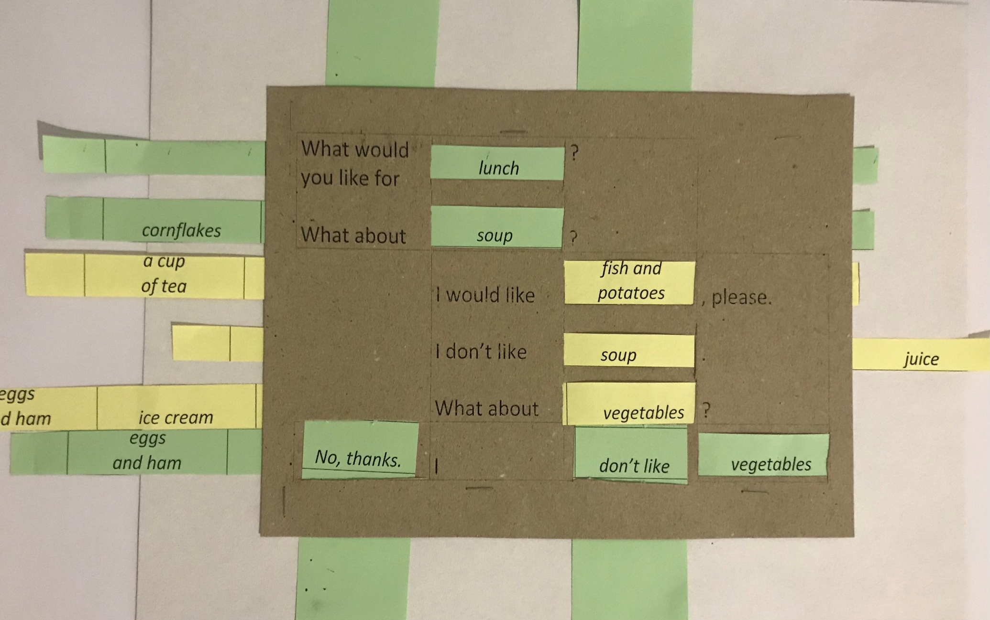

Slide 12
The End

